Slide 1
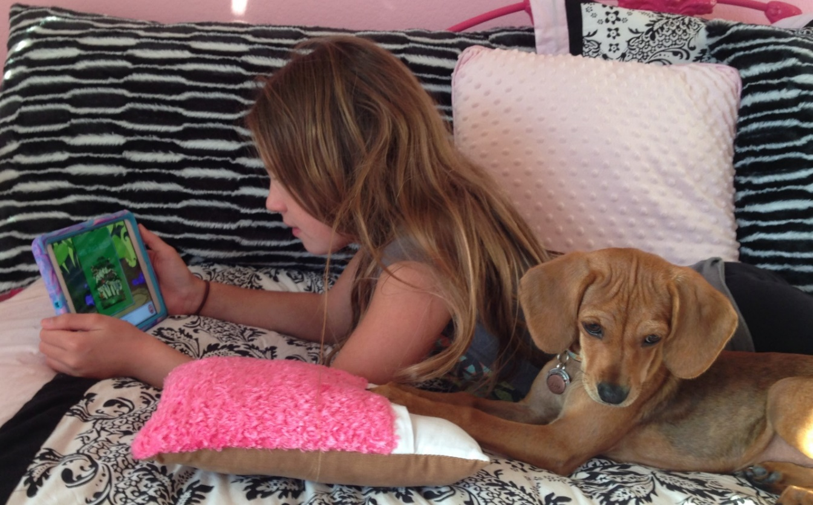
Welcome to Istation at Home!
Istation Support Services
Email: support@istation.com
Phone: 866-883-READ (7323) EXT: 2
Monday through Friday, 7:00 a.m.- 6:30 p.m. CST

Slide 3
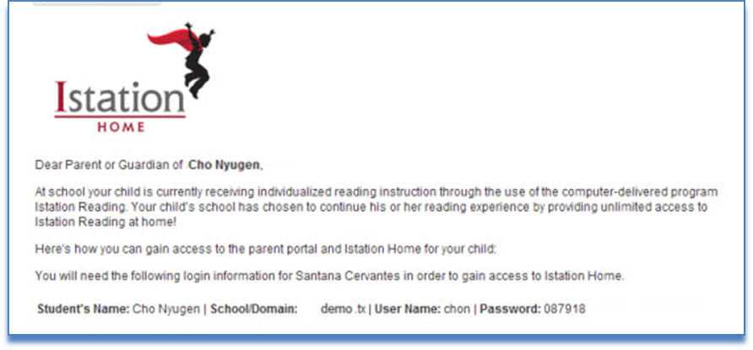
Parent Letter
What’s contained in the letter?
Student login information
Parent login information
How to download Istation
How a parent accesses reports
Help information

Slide 4
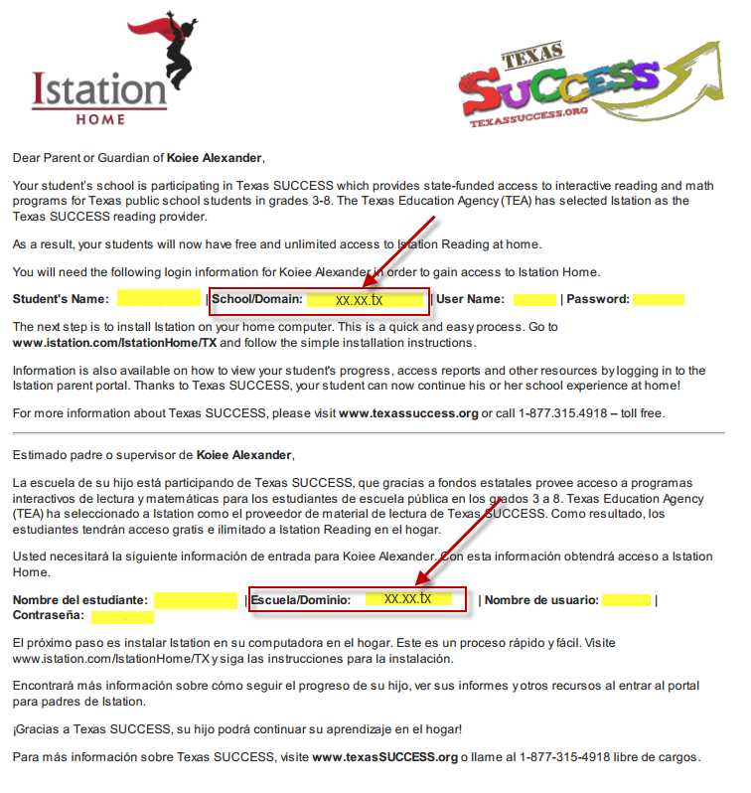
Everything you need is in your parent letter from Istation.
This letter will come from your child’s teacher.

Slide 5
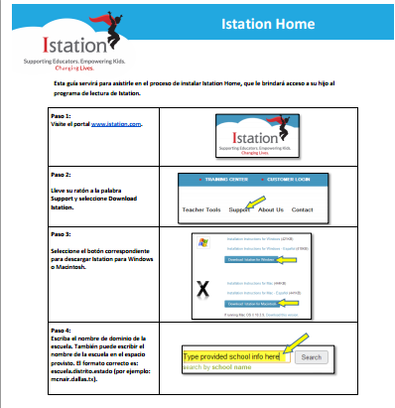
The Istation program must be downloaded on a computer or Ipad for use at home.
We are compatible with Macs, PCs, Chromebooks, and Ipads.
Instructions for downloading are available in English and Spanish.

Slide 6
Once the Istation student program is downloaded to your home computer, you will see this icon.
Your child uses their same login from school to access the program from home.

Slide 7
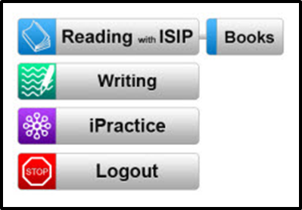
Student View of Istation Home
Once students log on to Istation Home, they will see the menu of items available.
Suggested weekly Istation schedule for home
Monday | Tuesday | Wednesday | Thursday | Friday
Ipractice (30 minutes) | Reading with ISIP (30 minutes) | Writing (30 minutes) | Free Read with Book of Choice or Istation Book Button | Ipractice (30 minutes)

Slide 8
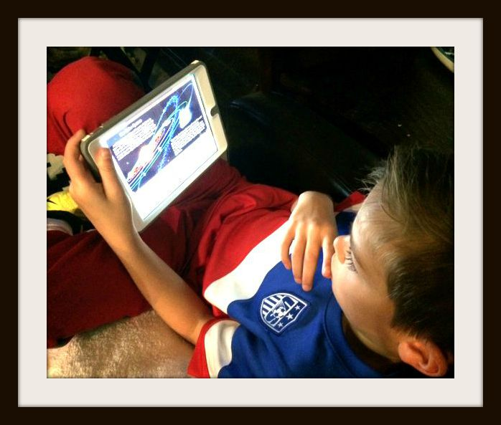
To access your child’s data and resources, you must go to the website:www.istation.com

Slide 9
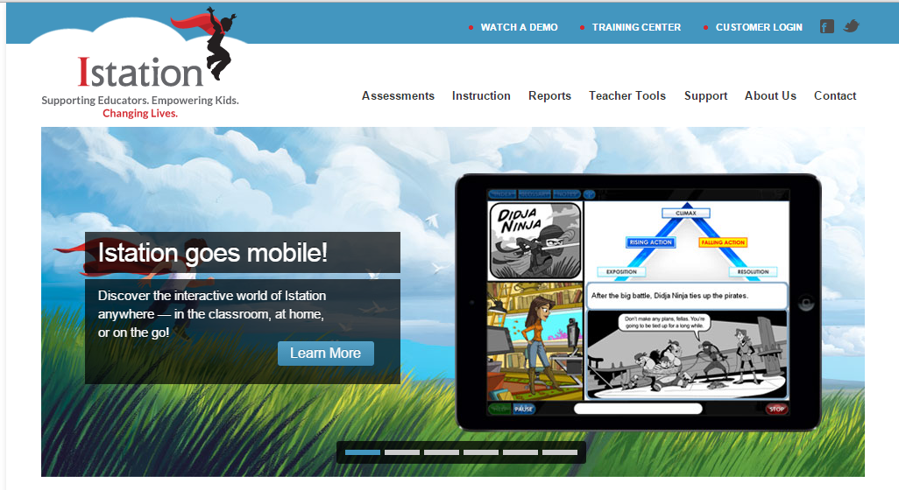
Go to: www.istation.com
Click customer login.

Slide 10
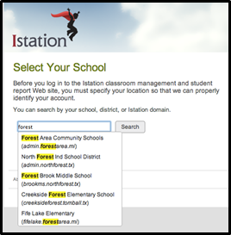
It may be necessary to select a domain.
Type in your school’s name.
Select your child’s school by clicking on it.
Be sure the school you select is in your school district. EX: Lewisville ISD

Slide 11
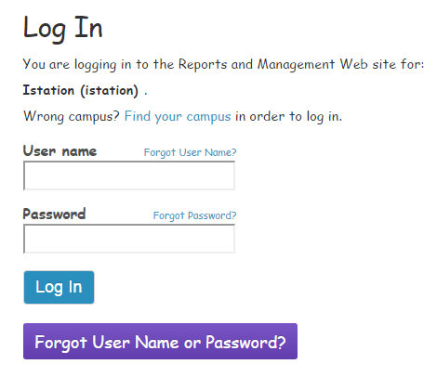
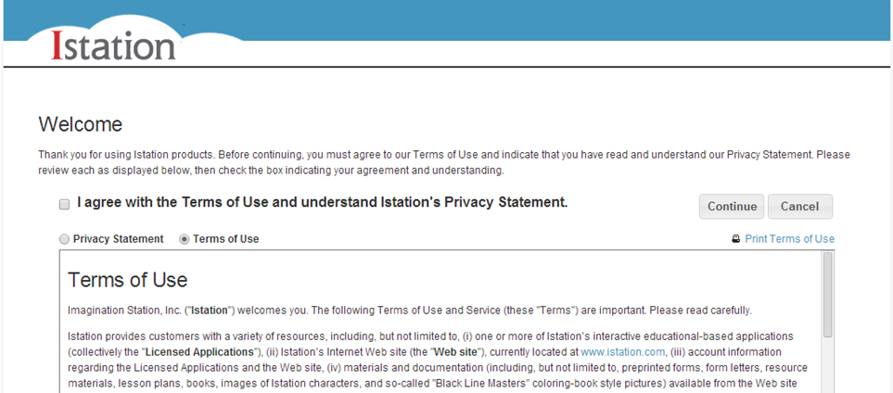
Enter your child’s username and password.
Remember, this information is located in your parent letter.
Contact your child’s teacher if you need the login information.
Accept Terms of use.

Slide 12
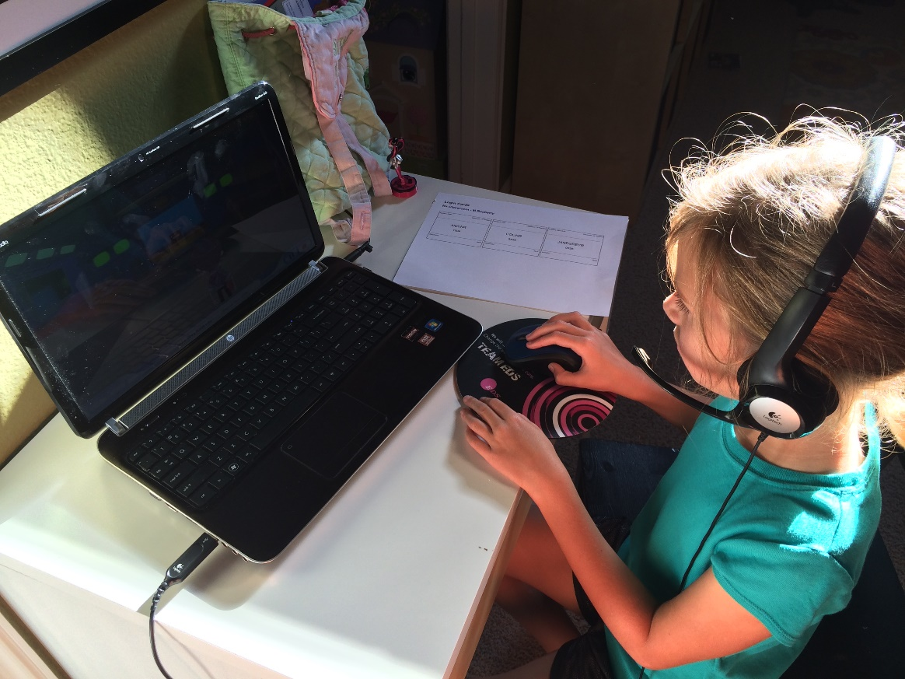
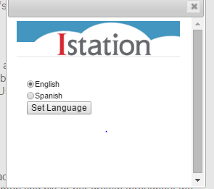
Once logged in to our website, www.istation.com, the language of the text can be switched from English to Spanish.

Slide 13
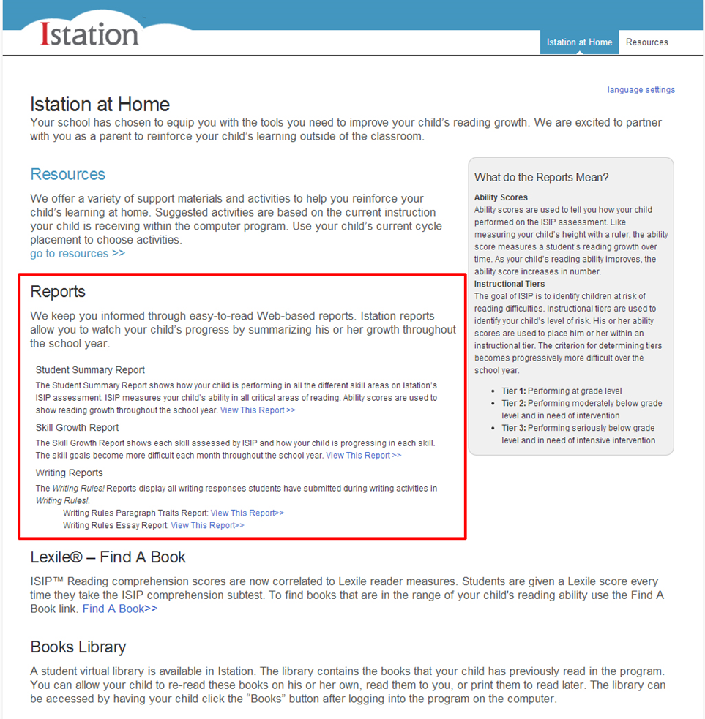
Parent view of the website
Resources
Reports
Lexile- Find a Book
Books Library

Slide 14
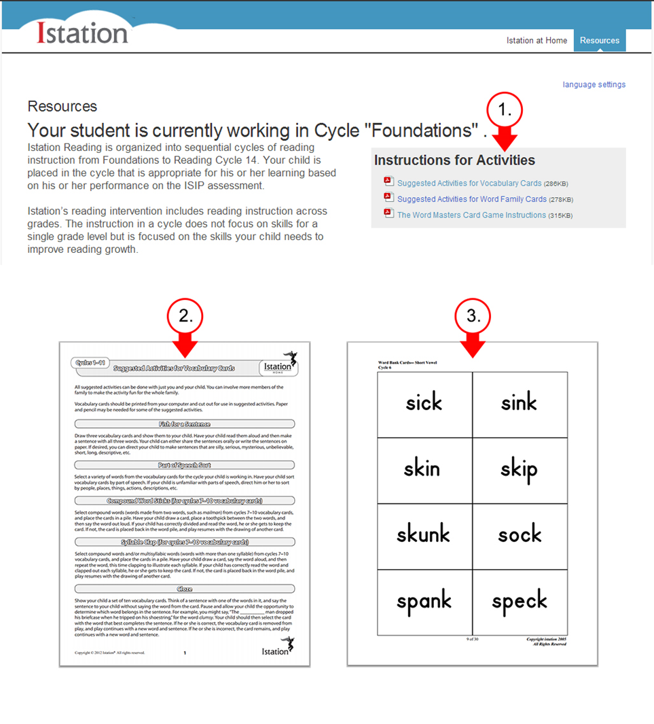
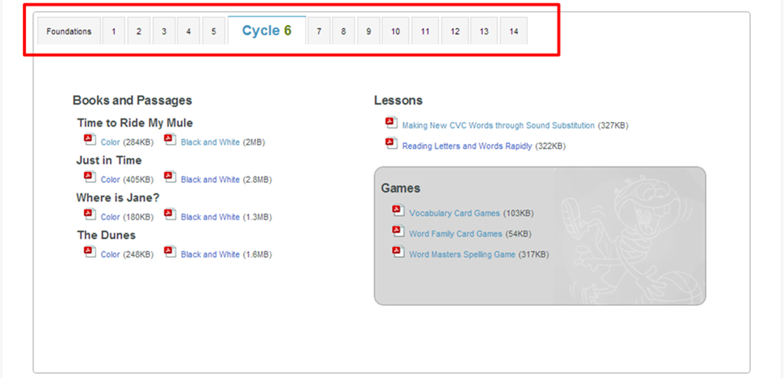
You will see what “cycle” your child is working in.
Links to activities and resources based on your child’s level are available.

Slide 15
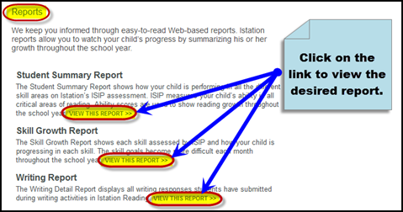
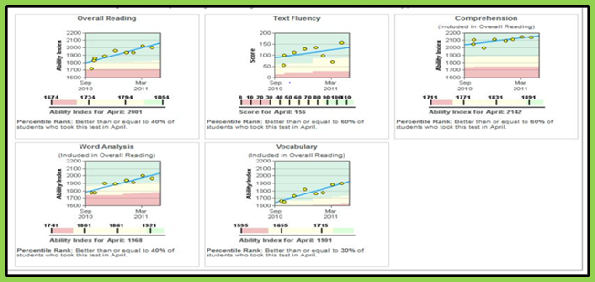
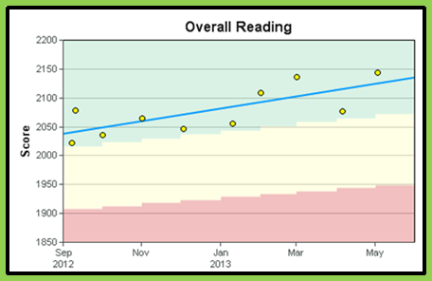
Links to reports specific to your child are provided.

Slide 16
Partnership
I dreamed that I stood in a studio and watched two sculptors there. The clay they used was a young child’s mind, and they fashioned it with care.
One was a teacher, the tools she used were books, music and art.
One was a parent with a guiding hand and a gentle loving heart.
Day after day the teacher toiled, with touch that was deft and sure. While the parents labored by her side and polished and smoothed it over.
And when at last their task was done, they were proud of what they had wrought.
For the things they had molded into the child could neither be sold nor bought.
And each agreed they would have failed if they had worked alone. For behind the parent stood the school And behind the teacher the home
Author Unknown

